Slide 1
ME 504 PROJECT NUMERICAL MODELING OF GRANULAR SALT
BRANDON LAMPE
LAXMI PANERU
MAY 6th , 2015

Slide 2
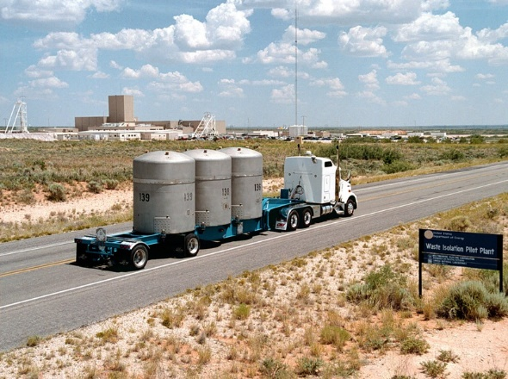
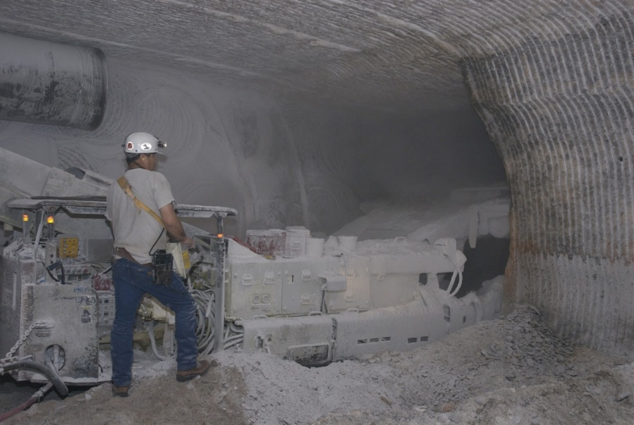
Fig 1: Nuclear waste being transported to WIPP facility for safe disposal.
INTRODUCTION
Salt is widely used for sealing the Waste Isolation Pilot Plant’s (WIPP) shafts, drifts, and boreholes.
Salt’s adequacy as a sealing material is dependent on the intrinsic permeability, whereas permeability is related to pore volume.
OBJECTIVE
Our objective is to predict volumetric strain from creep test data, performed earlier and recently at Sandia National Laboratories.
The numerical results from time dependent volumetric strain measured under a constant stress are analyzed using some constitutive models, and compared with results from Abaqus simulations.
Fig 2: Salt as a medium of nuclear waste disposal in repository.

Slide 3
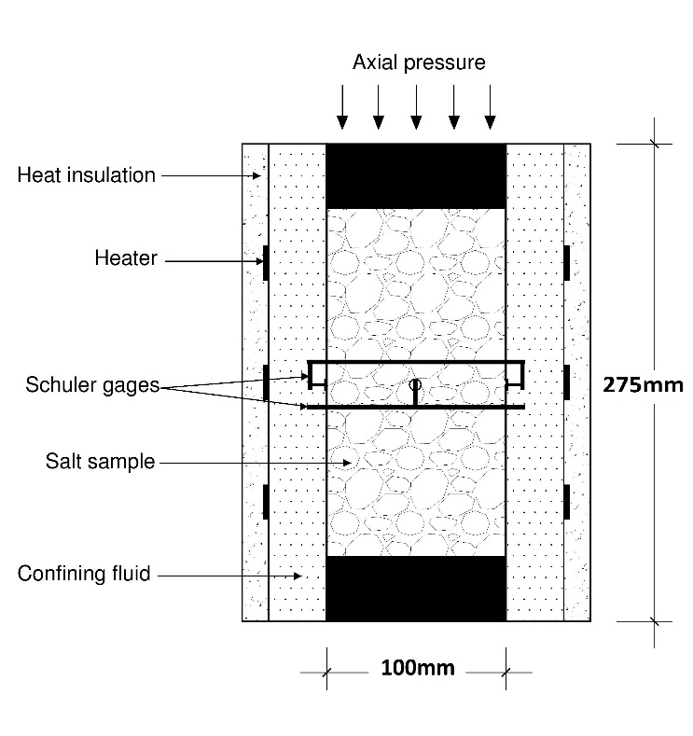
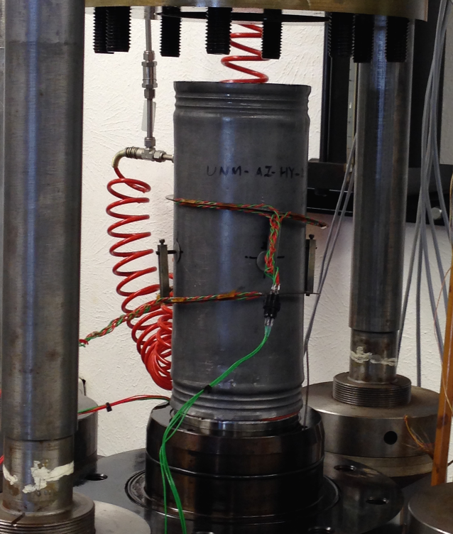
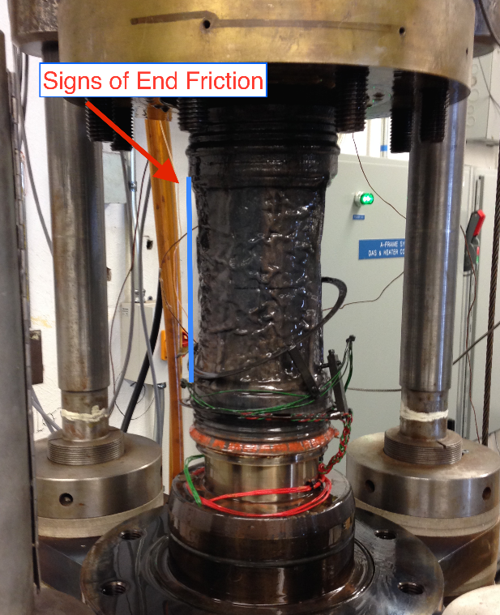
EXPERIMENTAL SETUP
Fig 3: Approximate specimen geometry.
Salt material was subjected to a triaxial test with confining pressure of 20 Mpa and axial force was applied via a hydraulic ram.
Axial displacement was measured by linear variable differential transformers (LVDTs).
Lateral deformation was measured by a pair of Schuler gages.
Volumetric strain was measured with a dilatometer.
Fig 4: Specimen before (left) and after (right) the test.

Slide 4
CONSTITUTIVE MODELS
Simulations of time dependent deformations during a creep were performed using the following constitutive models.
Linear isotropic viscoelasticity
Nonlinear isotropic viscoplasticity (CS model)
These models predict time dependent deformation, which is an observed phenomenon with crushed salt.
Isotropic elasticity tensor values used were:
Young’s modulus = 5,625 Mpa
Poission’s ratio = 0.75

Slide 5


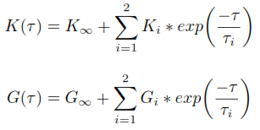

LINEAR ISOTROPIC VISCOELASTIC MODEL
The integral form of equation for linear isotropic viscoelastic material under hydrostatic stress utilized by Abaqus is;
Stress was defined in terms of a reduced time (τ), which is related to the simulation time through equation;
The relaxation functions, K(τ) and G(τ)
were defined in terms of Proney series as;
The Proney series parameters are;

Slide 6

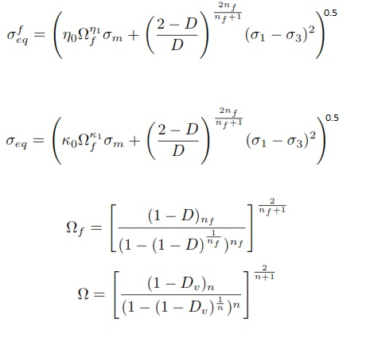

CS CONSTITUTIVE MODEL
The CS Model captures the operature deformation mechanisms in crushed salt, and dislocation creep, which is defined by;
The 13 parameters in CS Model were
fit using Markov Chain Monte Carlo
(MCMC) method, performed in R
programming language.
The predicted strain resulting from pressure
solutioning is defined by;

Slide 7
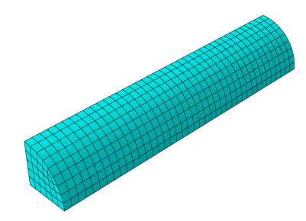
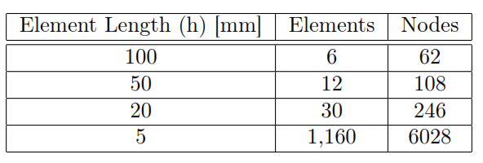
FINITE ELEMENT MODELING
Abaqus/CAE 6.14-1 was utilized to perform finite element analyses using a linear isotropic viscoelastic constitutive model.
8- node brick elements were used. Four different types of discretization were simulated and convergence of solution was confirmed.
Material: Aluminum end platens= Linear elastic
Salt sample= Linearly viscoplastic material
Boundary condtions: Upper platen= Essential BC, no displacement in z direction
Lower platen= Natural BC, Prescribed force
Curved face= constant pressure from confining fluid
Table 1: Description of discretization used.
Fig 5: Finite element discretization for h= 5mm.

Slide 8
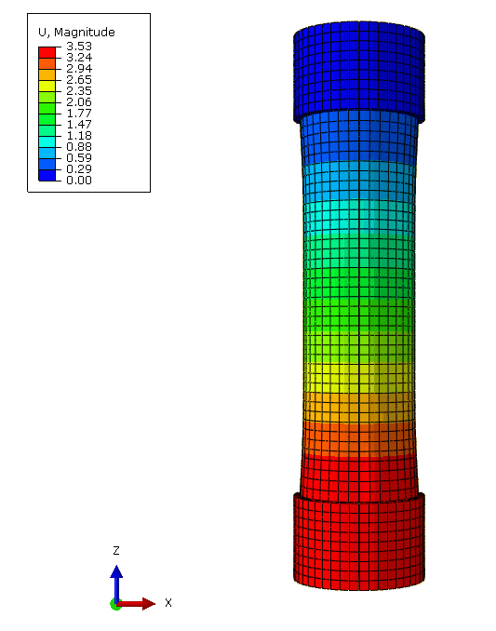
RESULTS
As a part of numerical analyses, a convergence study was completed to ensure sufficiently fine discretization has been employed.
Volumetric creep strain values (along the major principal axes) were obtained at a unique nodal point at the center of the specimen.
Displacement occurred in both the radial and axial direction during the test.
Fig 6: Radial and axial displacement in the sample.

Slide 9
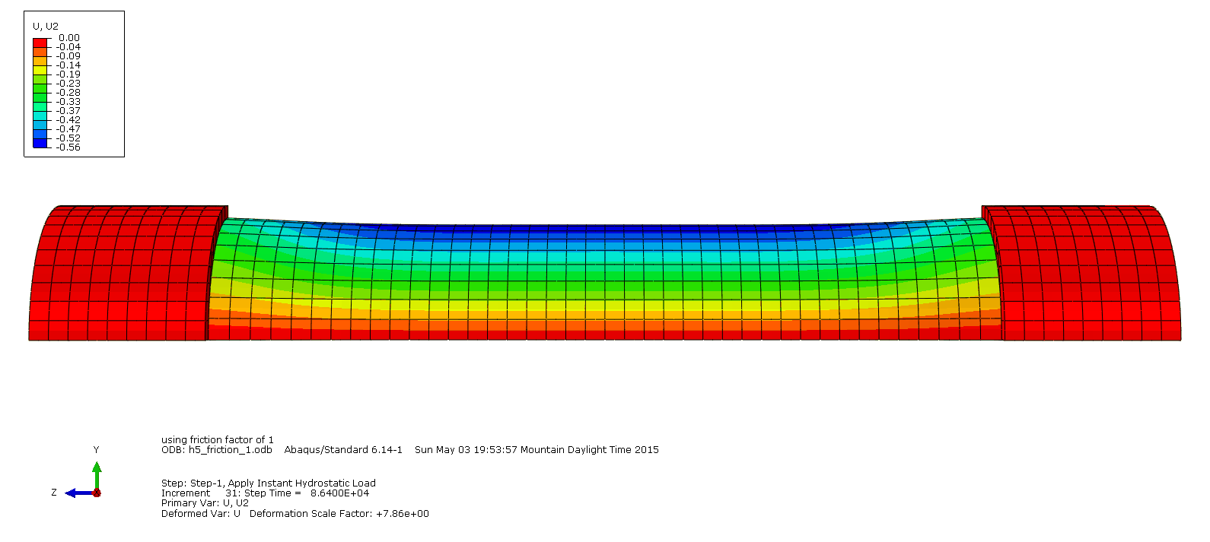
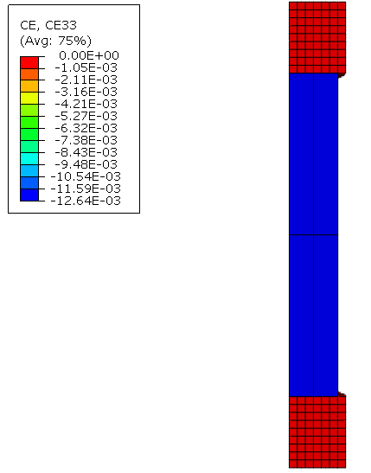
Fig 8: Cross section of radial displacement.
Fig 7: Volumetric strain along axial direction.

Slide 10
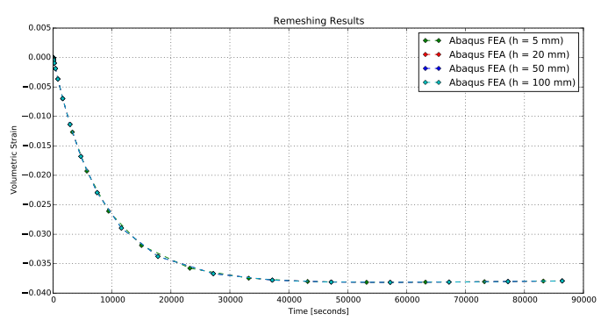
CONVERGENCE STUDY RESULTS

Slide 11
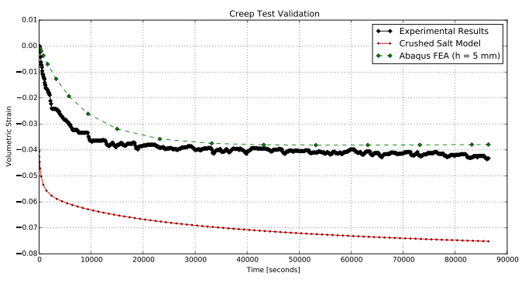
COMPARISION BETWEEN EXPERIMENTAL AND PREDICTED VOLUMETRIC CREEP STRAIN

Slide 12
CONCLUSION
In the convergence study, very little deviation in results was observed, which is likely a result of the problem definition, that being a hydrostatic stress applied to an isotropic material.
The influence of end friction was at least partially captured by the FE model, which is apparent by the additional stress near the end of specimen and reduced deformation near the specimen ends.
Both constitutive models are capable of predicting volumetric strain, similar to those measured during creep test.

Slide 13
THANK YOU

